Slide 1

微笑真的让人年轻？

Slide 2

真相究竟是怎样的呢？
是我们主观感受还是社会认知的影响？
微笑
真的会让人显得年轻么？

Slide 3
去寻找
我们一起，
答案.
跟着我
静一静，好么？
我们一起，

Slide 4

微笑使人显得年轻是一种普遍的信念
经验性的发现表明
微笑的面孔实际上被认为比中性的面孔更老
然而

Slide 5
你说儿豁？

Slide 6

就是这样
事实
没错

Slide 7
在这里,我们证明了这两个明显矛盾的现象可以在同一个人中 共存
在第一个实验中...
然而.....
微笑的面孔被认为比中性的面孔更年老

Slide 8
让他们做年龄的回顾性评价
实验结束后
然而.....

Slide 9
参与者却说
因吹斯听！
微笑面孔比中性面孔更年轻...
That's interesting

Slide 10
实验的具体操作呢？
Follow me！

Slide 11
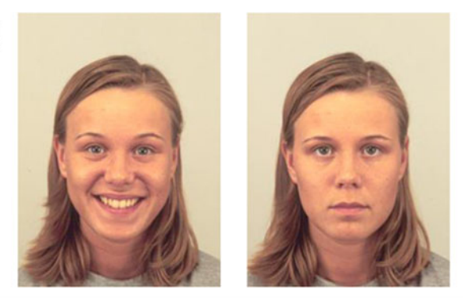
Experiment 1
Participants： Forty Ben Gurion University of the Negev students (23 females, mean age: 24.23 years) participated in the experiment.All participants had normal or corrected-to-normal vision .
Experimental design and procedure：
Photos of 35 women and 35 men (average age: 25 years),each with neutral and smiling expressions.
For example:

Slide 12
Experiment 1
Experimental design and procedure：
The 140 photos were divided into two equal sets: in Set A, a particular individual was smiling, while in Set B, he or she had a neutral expression (or vice versa).
Half the participants were presented with smiling faces from Set A and neutral faces from Set B.The other participants were presented with the reverse.
In each case, the faces from Sets A and B were presented in a random intermixed fashion. Participants were asked to evaluate the age of each face as accurately as possible.
Following the experimental session,they were told that they had just been presented with a series of smiling and neutral faces, and were asked to estimate the average age evaluations they had given.

Slide 13
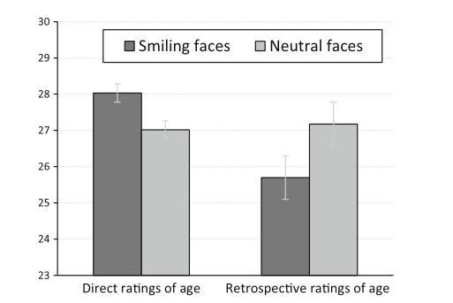
Experiment 1
Results:
The 70 individuals in the photos were rated as looking older in the direct evaluation part of the experiment than they were in retrospective reports, whether or not the individuals in the photos were smiling.

Slide 14
Experiment 1
Discussion：
①The results of Experiment 1 show a clear dissociation between people’s perception of facial age and between their beliefs about the effect smiling has on perceived age. In a recent study, we showed in a series of experiments that smiling faces are perceived as older than neutral faces of the same people due to the formation of smile-associated wrinkles in the region of the eye (Ganel, 2015), which is considered as crucial for face perception.
②The results of Experiment 1 also show that people believe that smiling makes faces appear younger Rather than older. This effect can probably be accounted for by the positive value associated with smiling across various social situations

Slide 15
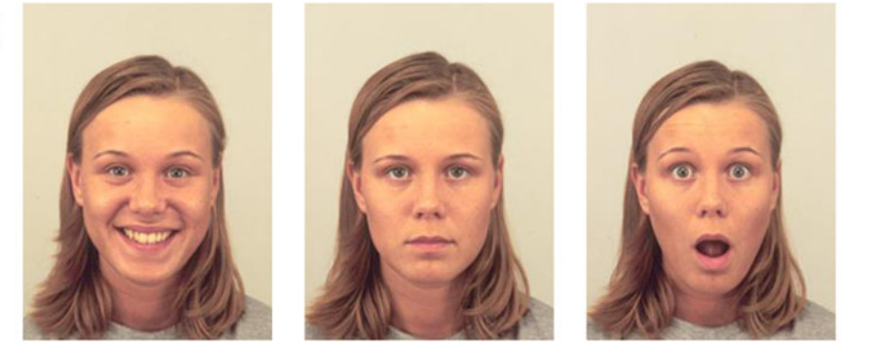
Experiment 2
Participants： Forty Ben Gurion University of the Negev students (23 females, mean age: 24.23 years) participated in the experiment.All participants had normal or corrected-to-normal vision .
Experimental design and procedure：
Photos of 35 women and 35 men (average age: 25 years),each with neutral , smiling and surprised expressions.
For example:

Slide 16
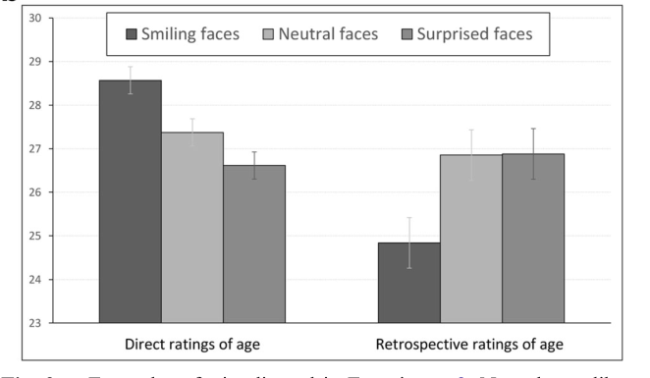
Experiment 2
Experimental design and procedure：Same as above
Results:

Slide 17
Experiment 2
Discussion：
①Direct and retrospective age evaluations of smiling and neutral faces followed the same pattern of results reported in Experiment 1. Specifically, smiling faces were again per-ceived as older than neutral faces, but retrospective reports again went in the opposite direction, with smiling faces erroneously reported as being younger than neutral faces
②Moreover, retrospective evaluations of age did not differ between surprised and between neutral faces.
③ participants’ retrospective evaluations revealed that they had rated surprised faces as appearing younger than neutral faces

Slide 18
Experiment 2
Discussion：
①The results of Experiment 1 show a clear dissociation between people’s perception of facial age and between their beliefs about the effect smiling has on perceived age. In a recent study, we showed in a series of experiments that smiling faces are perceived as older than neutral faces of the same people due to the formation of smile-associated wrinkles in the region of the eye (Ganel, 2015), which is considered as crucial for face perception.
②The results of Experiment 1 also show that people believe that smiling makes faces appear younger Rather than older. This effect can probably be accounted for by the positive value associated with smiling across various social situations

Slide 19
General discussion
The findings show, for the first time, that people can erroneously believe that smiling makes one appear younger,while at the same time rating smiling faces as older than neutral faces. Indeed, participants in our experiment were completely unaware that their perceptual performance defied their own beliefs.
Smiling faces are not perceived as younger than neutral faces;they are perceived as older.Moreover,our results make it clear that the same person can believe that smiling makes one appear younger,but at the same time judge smiling faces as older than neutral face

